Slide 1
Dr.r.s.gopika Prof ,Dept of Pathology skhmc
Skeletal - Diseases

Slide 2
Osteoblasts
Found in the new bone­forming surfaces.
synthesise bone matrix.
under control of calcitonin to take blood calcium and put it into bone
The serum marker for osteoblastic activity- bone­related alkaline phosphatase
- fracture repair and Paget’s disease of the bone

Slide 3
Osteocytes
are osteoblasts which incorporated into the bone matrix during its synthesis.
found within the lacunae lying in
the bone matrix.

Slide 4
Osteoclasts
are large multinucleate cells of mononuclear­macrophage origin and are responsible for bone resorption.
found along the endosteal surface of the cortical (compact) bone and the trabeculae of trabecular (cancellous) bone
under control of PTH to chew up the calcium of bone and put it into blood
Bone­related serum acid phosphatase levels

Slide 5
BONE DISEASES
Malformations
2) Diseases caused by defects in hormones and signal transduction mechanisms-
3) Ds associated with defects in extracellular structural proteins
4) Diseases associated with defects in folding and degradation of macromolecules

Slide 6
5) Diseases associated with defects in metabolic pathways
Osteopetrosis
6) Diseases associated with decreased bone mass
Osteoporosis
7) Diseases caused by osteoclast dysfunction
Paget Disease
8) Diseases associated with abnormal mineral (ca++) homeostasis
Ricketts and Osteomalacia
Hyperparathyroidism
Renal Osteodystrophy

Slide 7
MALFORMATIONS
Caused by defects in nuclear proteins and “transcription factors”
Congenital absence of a, usually single, bone: phalanx, rib, clavicle
Super numerary digit (polydactyly)
Syndactyly
Craniorachischisis

Slide 8
Craniorachischisis
Congenital malformations of the central nervous system and adjacent structures related to defective neural tube closure during the first trimester of pregnancy
generally occurring between days 18-29 of gestation.
Ectodermal and mesodermal malformations (mainly involving the skull and vertebrae) may occur as a result of defects of neural tube closure.

Slide 9
Diseases caused by defects
in hormones and signal transduction mechanisms
Achondroplasia, - dwarf (non-lethal)
Thanatophoria - dwarf (lethal, FGF-3
mutations)

Slide 10
Achondroplasia
is a major cause of dwarfism.
a point mutation in the fibroblast growth factor receptor 3 (FGFR3)
Autosomal dominant
Pathogenesis
activated FGFR3 inhibits chondrocyte proliferation
normal epiphyseal growth plate expansion is suppressed and long bone growth is severely stunted

Slide 11
Achondroplasia
Disproportionate dwarfism characterized by normal trunk & short limb.
Face appears small,the skull vault is normal but base is shortened

Slide 12
Thanatophoric Dwarfism
is a severe skeletal disorder characterized by
a disproportionately small ribcage,
extremely short limbs and
folds of extra skin on the arms and legs.

Slide 13
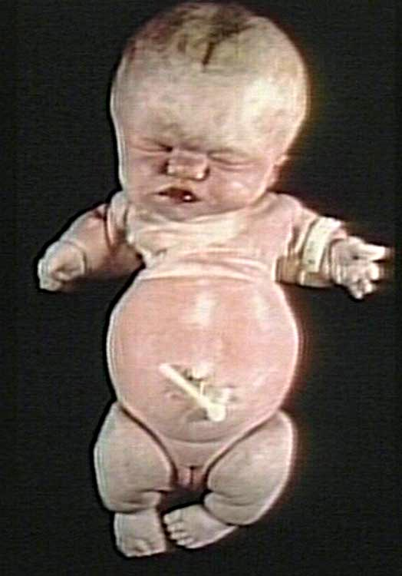
Thanatophoric “dwarf”, often lethal
Short arms and extra folds of skin
link.springer.com
Notes:
Achondroplastic and thanatophoric dwarfs, respectively

Slide 14
Osteogenesis Imperfecta
Autosomal dominant
Manifest as peculiar brittleness of the bones & pathological fractures.
Reduction in the production of type I collagen or formation of abnormal collagen due to mutations in the type I collagen genes.

Slide 15
Osteogenesis Imperfecta
Defective formation of osteoid with associated osteoporosis.
process of calcification is normal.
Severe skeletal deformities result from softening & bending of bones under stress
Repeated fractures with excessive callus formation.

Slide 16
Bone Fractures
A break in a bone
Types of bone fractures
Closed (simple) fracture – break that does not penetrate the skin
Open (compound) fracture – broken bone penetrates through the skin

Slide 17
Diseases associated with defects in metabolic pathways

Slide 18
OSTEOPETROSIS
group of rare genetic disorders characterized by
reduced osteoclast- mediated bone resorption and
therefore defective bone remodelling.

Slide 19
Diseases associated with decreased Bone mass

Slide 20
OSTEOPOROSIS
disease characterized by increased porosity of the skeleton resulting from reduced bone mass.
increase in bone fragility and susceptibility to fractures.
localized to a certain bone or region- disuse osteoporosis of a limb
Generalized -involve the entire skeleton- metabolic bone disease.

Slide 21
Causes -types
Generalised osteoporosis
Localised osteoporosis

Slide 22
Generalised osteoporosis
Idiopathic osteoporosis
-adult type
-juvenile type
Secondary osteoporosis
-senile osteoporosis
-prolonged bed rest
Endocrine abnormalities
-postmenopausal osteoporosis
-diabetes mellitus
-cushing syndrome
-hypogonadism
-hypopituitarism
- thyrotoxicosis
- hyperparathyroidism

Slide 23
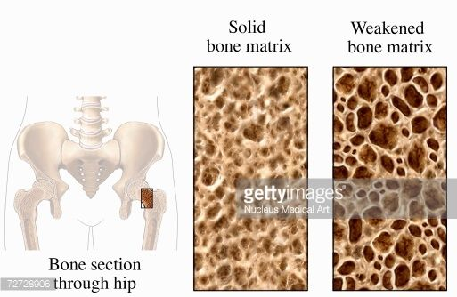

Slide 24
Osteoporosis
Nutritional causes:-
Protein malnutrition
Malabsorption syndrome
Scurvy
Alcoholism

Slide 25
Pathogenesis
In adults there is a dynamic equilibrium between bone formation by osteoblasts & maintenance by osteocytes, and resorption by osteoclasts
Osteoporosis occurs when the balance tilts in favour of resorption

Slide 26
c/f
Asymptomatic
Vertebral bodies soft & compressed.
Intervertebral discs herniate
Shortening of the vertebral column.
Dowager’s Hump / Widow’s Hump
-dorsal kyphosis with exaggerated cervical
lordosis.
fracture
Vague muscular aches
Pain
Kyphoscoliosis

Slide 27
Diseases caused by Osteoclast dysfunction

Slide 28
Paget’s disease of bone
Unknown etiology
Characterized by enlargement ,softening & deformity of several bone
After age of 40 yrs.
Men
THREE PHASES:
1) Increased osteoclast resorption
2) Increased “hectic” bone formation (osteoblasts)
3) Osteosclerosis

Slide 29
Pathology
Increased & disorderly formation & destruction of bone.
Bone is highly vascular
Marrow is replaced by highly vascular fibrous tissue.
Pelvis,femur,skull,tibia & vertebrae are affected

Slide 30
c/f
Femur & tibia undergo bowing & other deformities due to weight bearing
Overlying skin is warm due to increased vascularity.
Neurological complications.
Deafness
optic atrophy
paraplegia

Slide 31
Complication
Fractures
Progressive deformity
Cranial nerve palsies
Spinal cord compression
Degenerative joint disease
High output cardiac failure.
Osteogenic sarcoma.

Slide 32
Lab
Serum alkaline phosphatase is elevated
Serum calcium & phosphorus are normal.
Urinary hydroxyproline is increased
Confirmed by radiography
Bone –larger,chalky white & non homogeneous

Slide 33
POTT’S DISEASE /Tuberculosis Spondylitis
is an important form of osteomyelitis.
Infection causes vertebral deformity and collapse, with secondary neurologic deficits.
Extension of the infection to the adjacent soft tissues with the development of psoas muscle abscesses.
Early signs of the presence of Pott’s disease generally begin with back pain.

Slide 34
Diagnosis
Mantoux test - +ve.
X- ray of the affected joint & synovial biopsy help in confirming the diagnosis

Slide 35
Tumour-like lesions of bone
Fibrous dysplasia
Fibrous cortical defect
Solitary bone cyst
Aneurysmal bone cyst
Ganglion cyst

Slide 36
Fibrous dysplasia
is a benign
replacement of bone by fibrous connec tive tissue with a characteristic whorled pattern and containing trabeculae
of woven bone.
Radio logically, - fibrous dysplasia has well­demarcated ground­glass appearance.

Slide 37
Fibrous cortical defect
metaphyseal fibrous defect
occurs in the metaphyseal cortex of long bones in children,
commonly on upper or lower end of tibia or lower end of femur .

Slide 38
Solitary, simple bone cyst
is a benign
in children and adolescents,
frequently located in the metaphyses at the upper end of humerus and femur.
The cyst expands the bone causing thinning of the overlying cortex

Slide 39
Aneurysmal bone cyst
expanding osteolytic lesion filled with
under 30 years
shafts of metaphyses of long bones or the vertebral column.
X-ray- ballooned­out expansile lesion underneath the periosteum.
c/f- produce pain, tenderness and pathologic fracture

Slide 40
BONE TUMORS
Bone tumours arising from different tissue components
osseous
non­osseous

Slide 41
Bone- Bone tumors
Osteoma
Osteoid osteoma (nidus)
Osteoblastoma
Osteosarcoma (osteogenic sarcoma)

Slide 42
Bone- cartilage tumors
Osteochondroma (exostosis)
Chondroma
Chondroblastoma
Chondromyxoid fibroma
Chondrosarcoma

Slide 43
Osteoma
Facial bones, skull
40-50yrs
usually solitary and present as localized, slowly growing, hard, exophytic masses on the bone surface
histologically resemble normal bone

Slide 44
Osteoid osteoma
10-20yrs
M:F - 2 : 1
arise most often in the proximal femur and tibia, and are less than 2 cm,
Cortical tumors,
characterized by pain;

Slide 45
Osteoblastoma
Vertebral column
10-20yrs
Arise in vertebral transverse and spinous processes;
Larger
Histologically: similar to osteoid osteoma

Slide 46
Morphology
Grossly
both lesions are round-to-oval masses of hemorrhagic gritty tan tissue.
A rim of sclerotic bone is present at the edge of both types of tumors; it is much more in osteoid osteomas
Microscopically
both are composed of interlacing trabeculae of woven bone surrounded by osteoblasts
The intervening stroma is loose, vascular connective tissue containing variable numbers of giant cells.

Slide 47
Osteochondroma
Cartilaginous
Metaphysis of long tubular bones
10-30 yrs
Bony excrescences with a cartilaginous cap
solitary or multiple and hereditary
slow-growing masses that are painful when they impinge on a nerve or if the stalk is fractured

Slide 48
Morphology
1-20cm in size.
The cap is benign hyaline cartilage
Newly formed bone forms the inner portion of the head and stalk, with the stalk cortex merging with the cortex of the host bone

Slide 49
Chondromas
are benign tumors of hyaline cartilage.
2 types
Enchondromas -
arise within the medulla,
juxtacortical chondromas -
when on the bone surface

Slide 50
Enchondromas
ages - 20 – 50yrs
they are typically solitary
located in the metaphyseal region of tubular bones
esp: short tubular bones of the hands and feet

Slide 51
Enchondromas
gray-blue, translucent nodules usually smaller than 3 cm
Microscopically
well-circumscribed hyaline matrix and cytologically benign chondrocytes
x-ray- unmineralized nodules of cartilage produce well-circumscribed oval lucencies surrounded by thin rims of radiodense bone (O-ring sign).

Slide 52
Malignant tumours
Osteosarcoma
is the most common primary malignant tumor of bone,
20% of primary bone cancers.
occur in all age groups
75% of patients are younger than age 20, with a second peak occuring in the elderly.

Slide 53
Osteosarcoma
usually with other conditions(Paget disease, bone infarcts, and prior irradiation).
Men :women (1.6 : 1).
most tumors arise in the metaphyseal region of the long bones of the extremities.
60% occurring about the knee, 15% around the hip, 10% at the shoulder, and 8% in the jaw

Slide 54
Primary osteosarcoma
Metaphysis of distal femur, proximal tibia, and humerus
10-20 yrs
Grow outward, lifting periosteum, and inward to the medullary cavity;
microscopically
malignant cells form osteoid , cartilage may also be present

Slide 55
Secondary osteosarcoma
Femur, humerus, pelvis
>40yrs
Complications of polyostotic Paget disease;
histologically
similar to primary osteosarcoma

Slide 56
Pathogenesis & Clinical Features
present as painful enlarging masses,
pathologic fracture can be the first symptom.
x-ray - a large, destructive, mixed lytic and blastic mass with indistinct infiltrating margins.
The tumor breaks through the cortex and lifts the periosteum, resulting in reactive periosteal bone formation.
A triangular shadow on x-ray between the cortex and raised periosteum (Codman triangle)).

Slide 57
spread
hematogenously;
at the time of diagnosis, approximately 10% to 20% of patients have demonstrable pulmonary metastases

Slide 58
Distal femoral osteosarcoma with prominent bone formation extending into the soft tissues.
The periosteum, which has been lifted, has laid down a proximal triangular
shell of reactive bone /Codman triangle (arrow).

Slide 59
Morphology
-gritty, gray-white tumors, often exhibiting hemorrhage and cystic degeneration.
- Tumors frequently destroy the surrounding cortices and produce soft tissue masses
spread extensively in the
medullary canal, infiltrating and
replacing the marrow,
Rarely penetrating the
epiphyseal plate or entering
the joint space.

Slide 60
Microscopical
Tumor cells vary in size and shape,
frequently have large hyperchromatic nuclei
bizarre tumor giant cells

Slide 61
Chondrosarcoma
Bones of shoulder, pelvis, proximal femur, and ribs
40-60 yrs
Arise within medullary cavity and erode cortex
They typically present as painful, progressively enlarging masses
metastasize hematogenously, - to the lungs and skeleton
microscopically
well differentiated cartilage-like or anaplastic

Slide 62
Giant-cell tumor / GCTs
usually benign
20-40 yrs
arise in the epiphysis of long bones around the knee (distal femur and proximal tibia), causing arthritis-like symptoms.
Radiographically, - large, purely lytic, and eccentric; the overlying cortex is frequently destroyed, producing a bulging soft tissue mass with a thin shell of reactive bone

Slide 63
Pathology
Tumors are solitary, large and red-brown with frequent cystic degeneration.
Necrosis, hemorrhage, and reactive bone formation are also commonly present.
MICRO-
They are composed of uniform oval mononuclear cells with frequent mitoses, with scattered osteoclast-type giant cells containing 100 or more nuclei

Slide 64
Ewing Sarcoma
primary malignant small round-cell tumors of bone and soft tissue
chromosome translocation,
t(11;22) (q24;q12) or t(21;22) (q22;q12).
the second most common pediatric bone sarcomas
arise in the medullary cavity and invade the cortex and periosteum to produce a soft tissue mass

Slide 65
Morphology
The tumor is tan-white, frequently with hemorrhage and necrosis.
histopathology
composed of sheets of uniform small, round cells that are slightly larger than lymphocytes with few mitoses and little intervening stroma .
The cells have scant glycogen-rich cytoplasm.

Slide 66
c/f
painful enlarging masses in the diaphyses of long tubular bones (especially the femur) and the pelvic flat bones.
systemic signs and symptom- fever, elevated ESR rate, anemia, and leukocytosis.
X-rays - destructive lytic tumor with infiltrative margins and extension into surrounding soft tissues.
There is a characteristic periosteal reaction depositing bone in an onionskin fashion

Slide 67
Metastatic bone tumours
Male: prostate
Female: breast
Other sites - Renal, thyroid

Slide 68
References
Robbinson- Basic Pathology
Harsh Mohan-Text book of Pathology
Robin Reid-Pathology Illustrated
https://www.pinterest.com/

